Slide 1




EMPLOYEE ATTRITION PREDICTION PROCESS & MODELING APPROACH
PREPARED BY RAJKAMAL DAS

Slide 2

ABSTRACT
This project analyzes employee attrition using supervised machine learning. The goal was not only to predict attrition but to understand the driving factors behind it. Logistic Regression & Random Forest was tested. Logistic Regression was selected for the final model due to its interpretability, allowing feature-level insight into risk contributors.

Slide 3

INTRODUCTION
HR attrition impacts organizational stability
Data-driven insights improve retention planning
Machine learning helps quantify risk factors

Slide 4

GOALS
Clean and preprocess dataset
Build predictive model
Interpret model outputs for business reasoning

Slide 5
METHODOLOGY
Data Cleaning & Feature Engineering
Handling Redundant Features
Encoding & Scaling
Model Training (Logistic Regression, Random Forest)
Evaluation (Precision, Recall, F1)

Slide 6
TOOLS & LIBRARIES
Python 3
Pandas
OS
Kagglehub
Matplotlib
Seaborn
Sci-kit learn
Models
Data splitting
Evaluation Metrics

Slide 7
DATA UNDERSTANDING
Dataset contains employee-level HR data
Target variable: Attrition (Yes/No)
Mixed numerical and categorical features

Slide 8
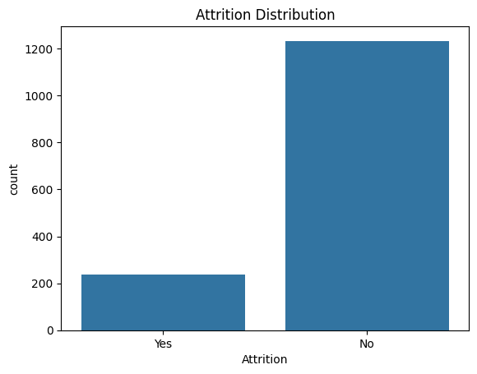
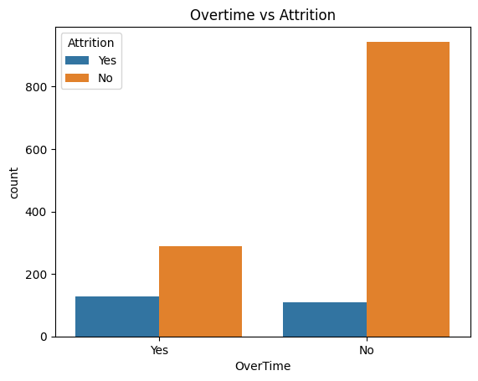
DATA UNDERSTANDING

Slide 9
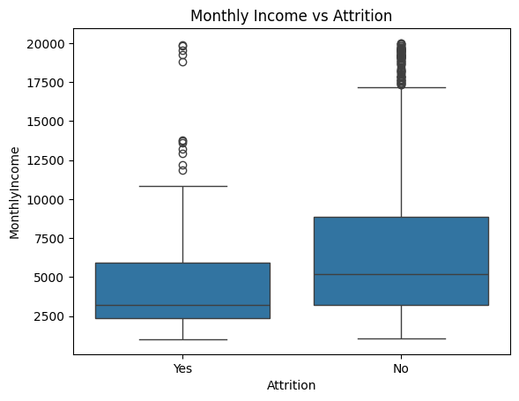
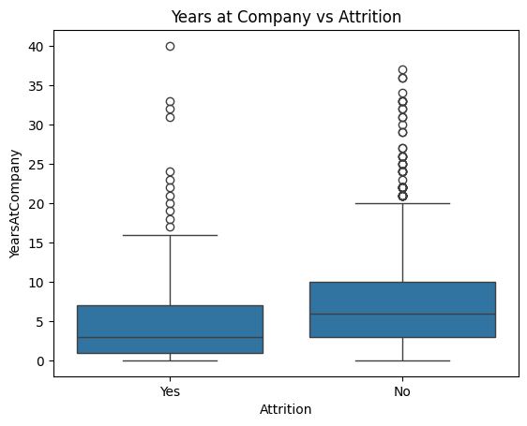
GRAPHS

Slide 10
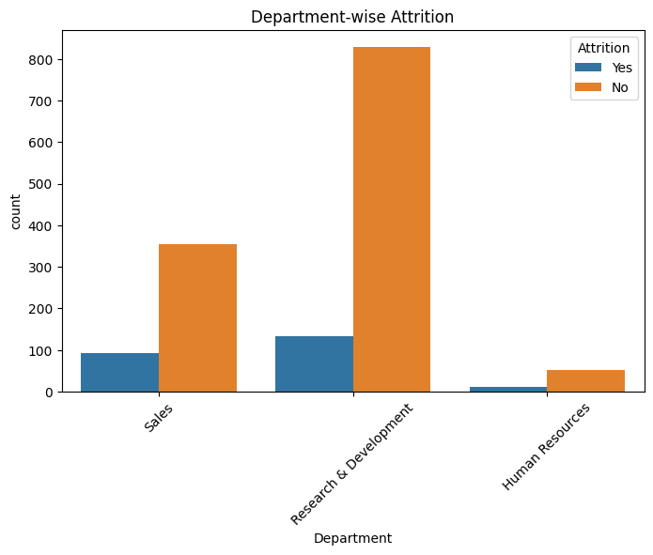
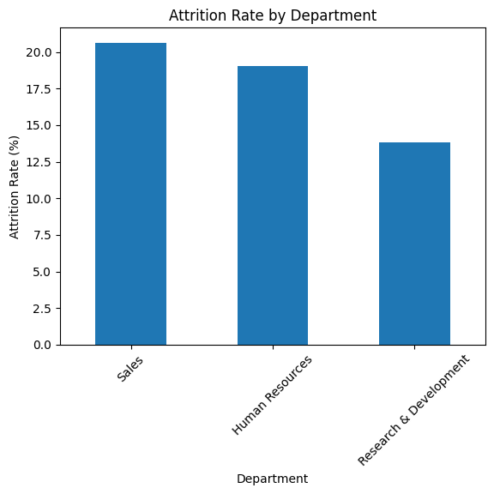
GRAPHS

Slide 11
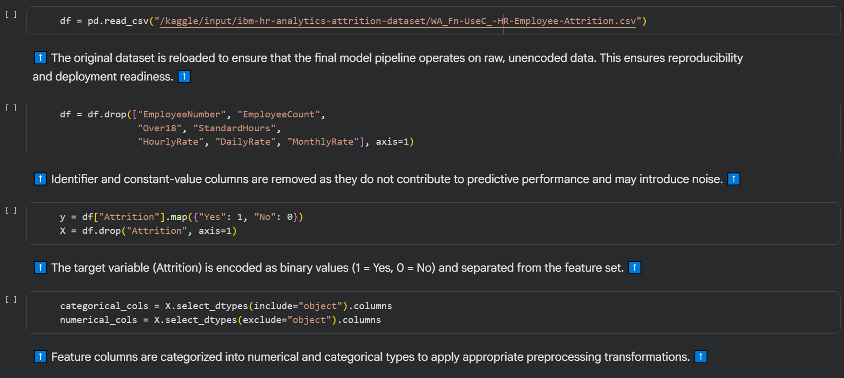
CODE SCREENSHOTS

Slide 12
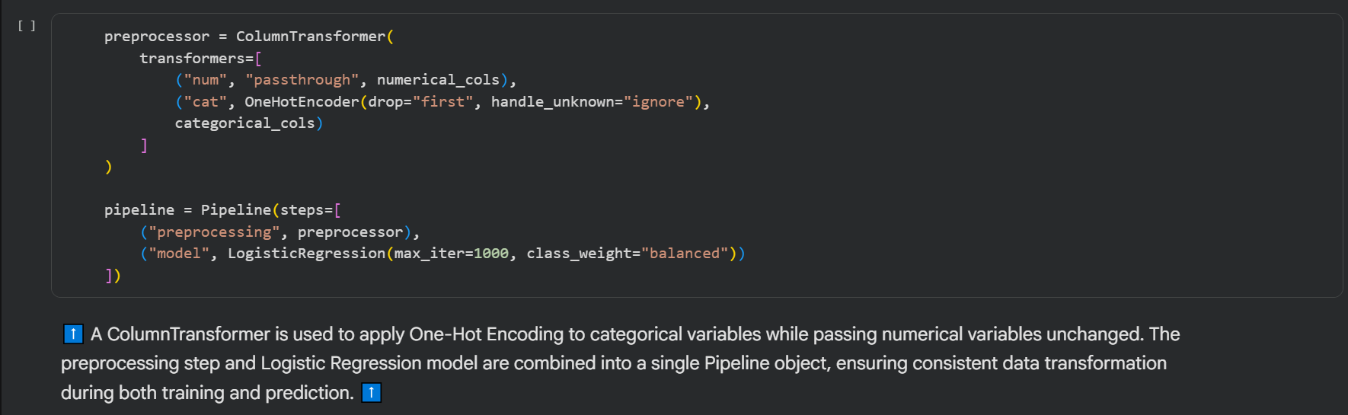
CODE SCREENSHOTS

Slide 13
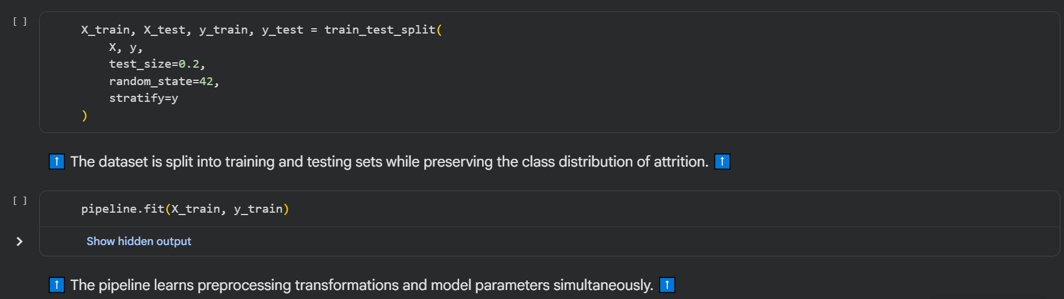
CODE SCREENSHOTS

Slide 14
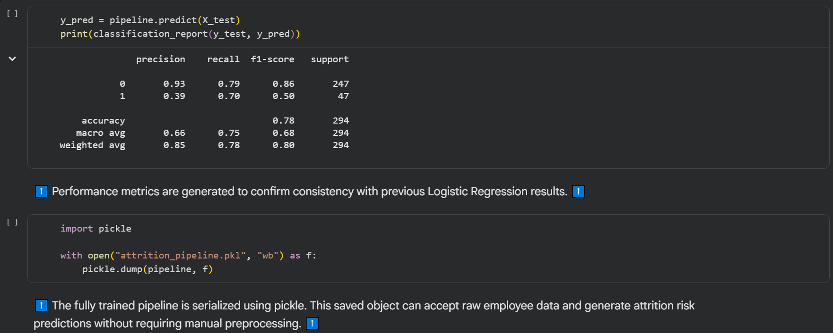
CODE SCREENSHOTS

Slide 15
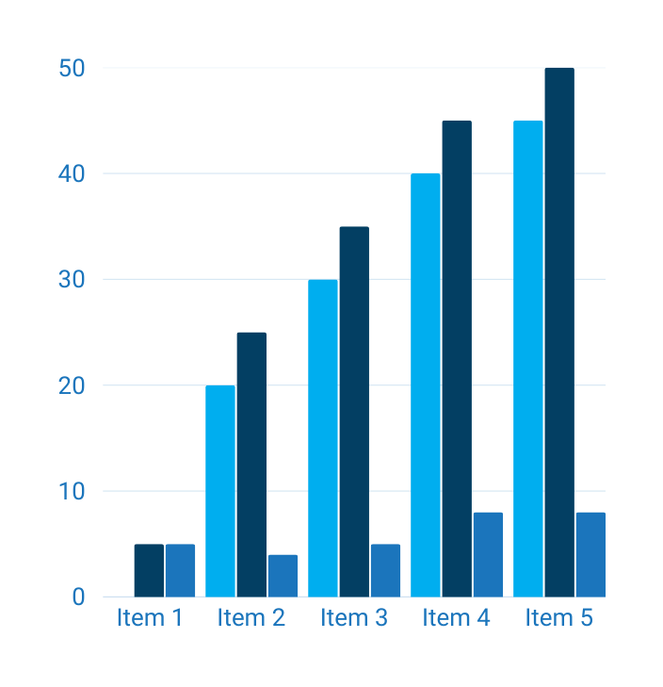
RESULT
Balanced precision and recall achieved
Focus placed on minority class detection
Key predictors identified through coefficient analysis
Model performance improved after removing redundant features

Slide 16
CONCLUSION
Logistic Regression provided interpretable results
Structured pipeline ensured reproducibility
Model insights support data-backed HR decisions

Slide 17
THANK
you

